Slide 1

Machine Learning for Engineers: Classification
Mina Farmanbar
Associate Professor, University of Stavanger
for engineers

Slide 2
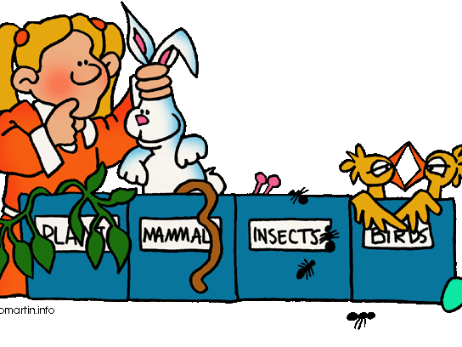
What is Classification
Classification is something that we all do intuitively in our daily life and see around us lots of examples that illustrate classification.
http://bit.ly/3VGbvyC

Slide 3
What is Classification
In machine learning classification:
A supervised learning approach
Categorizing or classifying some unknown items into a discrete set of classes.
The target attribute is a categorical variable

Slide 4

Classification in Real Life
Healthcare
During the COVID-19 pandemic, machine learning models were implemented to efficiently predict whether a person had COVID-19 or not.

Slide 5

Classification in Real Life
Education
The classification of documents per category.
Analysis of students’ feedback sentiments about a Professor.

Slide 6

Classification in Real Life
Transportation
To predict which geographical location will have a rise in traffic volume.
Predict potential issues that may occur in specific locations due to weather conditions.

Slide 7
Different Types of Classification Tasks
There are three main classification tasks in Machine learning:
Binary classifications
Multi-class classifications
Multi-label classifications

Slide 8
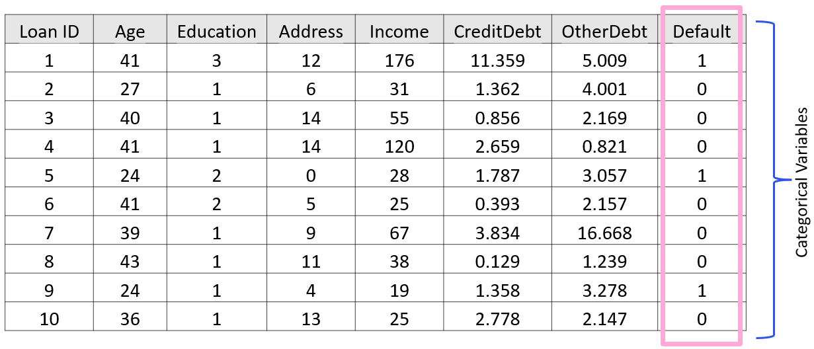
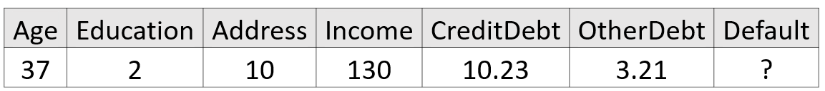
How does Classification Work?

Slide 9
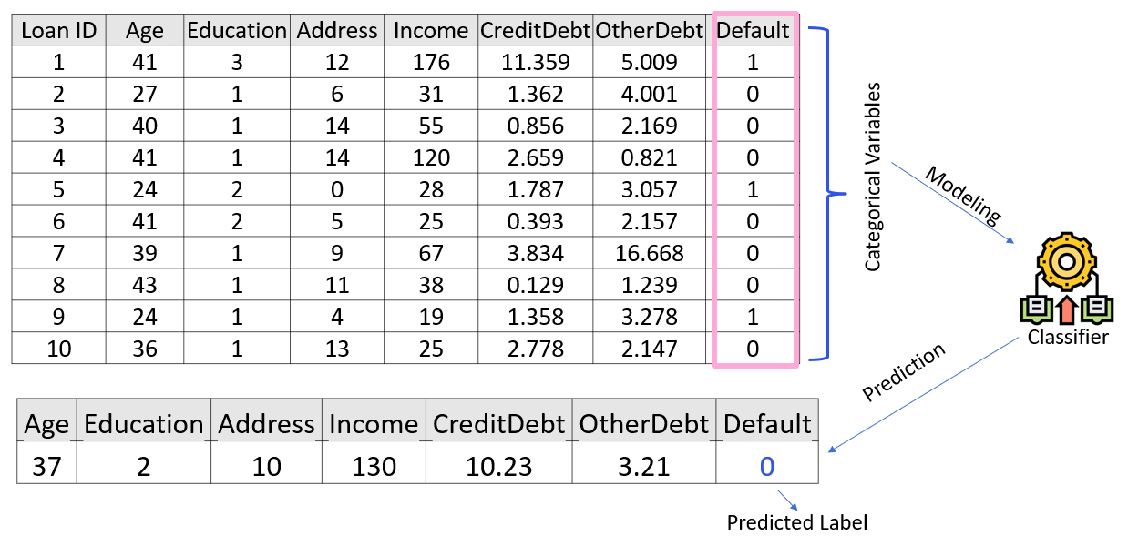
How does Classification Work?

Slide 10
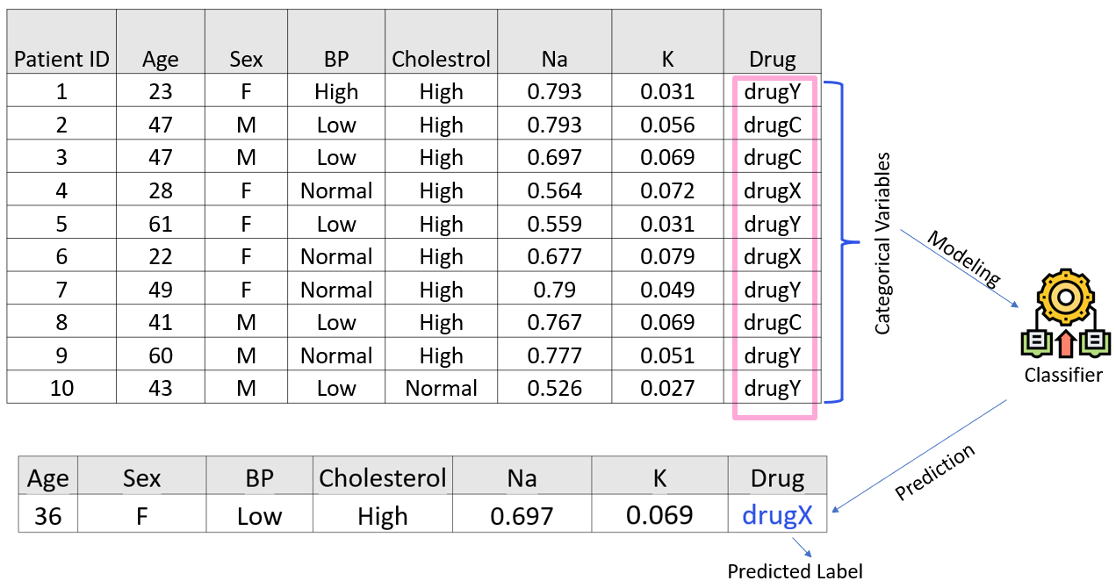
How does Multi-class Classification Work?

Slide 11
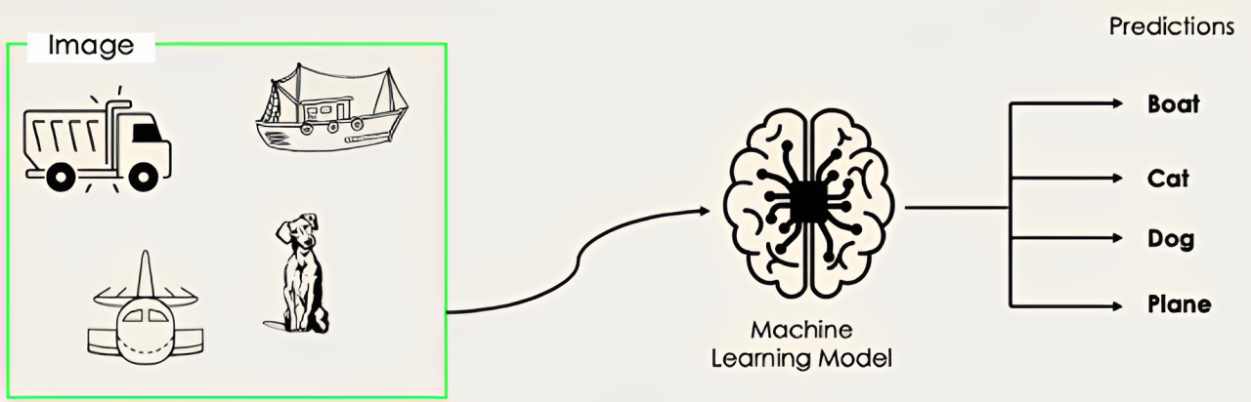
How does Multi-label Classification Work?
In multi-label classification tasks, we try to predict 0 or more classes for each input example.
https://bit.ly/3xLn13z

Slide 12
Classification Algorithms
Decision Trees
K-Nearest Neighbor
Neural Networks
Support Vector Machines (SVM)

Slide 13
Summary
Classification can be used for:
Email filtering
Speech recognition
Handwriting recognition
Biometric identification
Document classification and much more.

Slide 14
Thank you
Mina Farmanbar
mina.farmanbar@uis.no

